Slide 1
How do I launch a Mojaloop based payments scheme?
A Product View:
What Does Mojaloop Do, How Do I Get One, and How Do I Onboard Some DFSPs?

Slide 2
Agenda
Elements of a Mojaloop-Based Scheme
Use-Cases
Software Deployment
Participant Onboarding
Next Steps

Slide 3
The Mojaloop Ecosystem
An introductory glossary for newcomers

Slide 4
Core Functions
Payee address or alias resolution, ensuring that the account-holding institution – and thereby the correct payee account - is reliably identified
Clearing of payments end to end, with robust measures that remove any element of doubt about the success of a transaction
Orchestration of Settlement of cleared transactions between financial institutions using a model agreed between those institutions, and according to a predefined schedule.

Slide 5
Ecosystem
Oracle
Oracle
Settlement Partner
Oracle
ALS
Oracle
DFSP
DFSP
Mojaloop Hub
Back Office
Integration Tools
Integration Tools
Back Office
Fintech
Core Connector
Mojaloop Connector
PISP I/F
Integration Tools
Consumer Service

Slide 6



The Three Key Phases of a Mojaloop Transaction
Discovery, when the Payer's DFSP works with the Mojaloop Hub to determine where the payment should be sent. This phase resolves an alias to a specific Payee DFSP and, in collaboration with that DFSP, an individual account.
Agreement of Terms, or Quotation, when the two DFSP parties to the transaction agree that the transaction can go ahead (supporting, for example, restrictions relating to tiered KYC, or accounts which might be disabled for whatever reason), and on what terms (including fees).
Transfer, when the transaction between the two DFSPs (and by proxy their customers' accounts) is cleared.

Slide 7
Use Cases

Slide 8
Base Use Cases
A Mojaloop Hub's core function is the clearing of the transfer of funds between two accounts (account to account, or A2A), each of which is held at a DFSP connected to the Hub, commonly referred to as a push payment. This fundamental A2A capability enables it to support a wide range of use cases.
This means that, at the most basic level, a Mojaloop Hub directly supports the following use cases:
Person to Person (P2P);
Person to Business (P2B), including simple forms of merchant payments, both face to face and remote (online);
Business to Business (B2B);
Business to Government (B2G);
Simple forms of Person to Government (P2G) payments

Slide 9
More Complex Use Cases
In addition to the A2A-based use cases, Mojaloop supports more complex use cases, using a range of different functionalities which add additional features and are layered over the top of the core use cases, including:
Functionality | Use Cases
Request to Pay | Merchant payments, billing, collections
Cash Services | Cash in/out, cardless ATM, offline cash
3PPI/PISP | Fintechs, governments, DFSPs and others, offering payments, salary, bulk and other services independently of DFSPs
Bulk Payments | Pensions, social payments, salaries
Cross Border | A2A and merchant payments
Also supports the implementation of more complex use cases by adopters – for example, in complex P2G or G2P payments

Slide 10
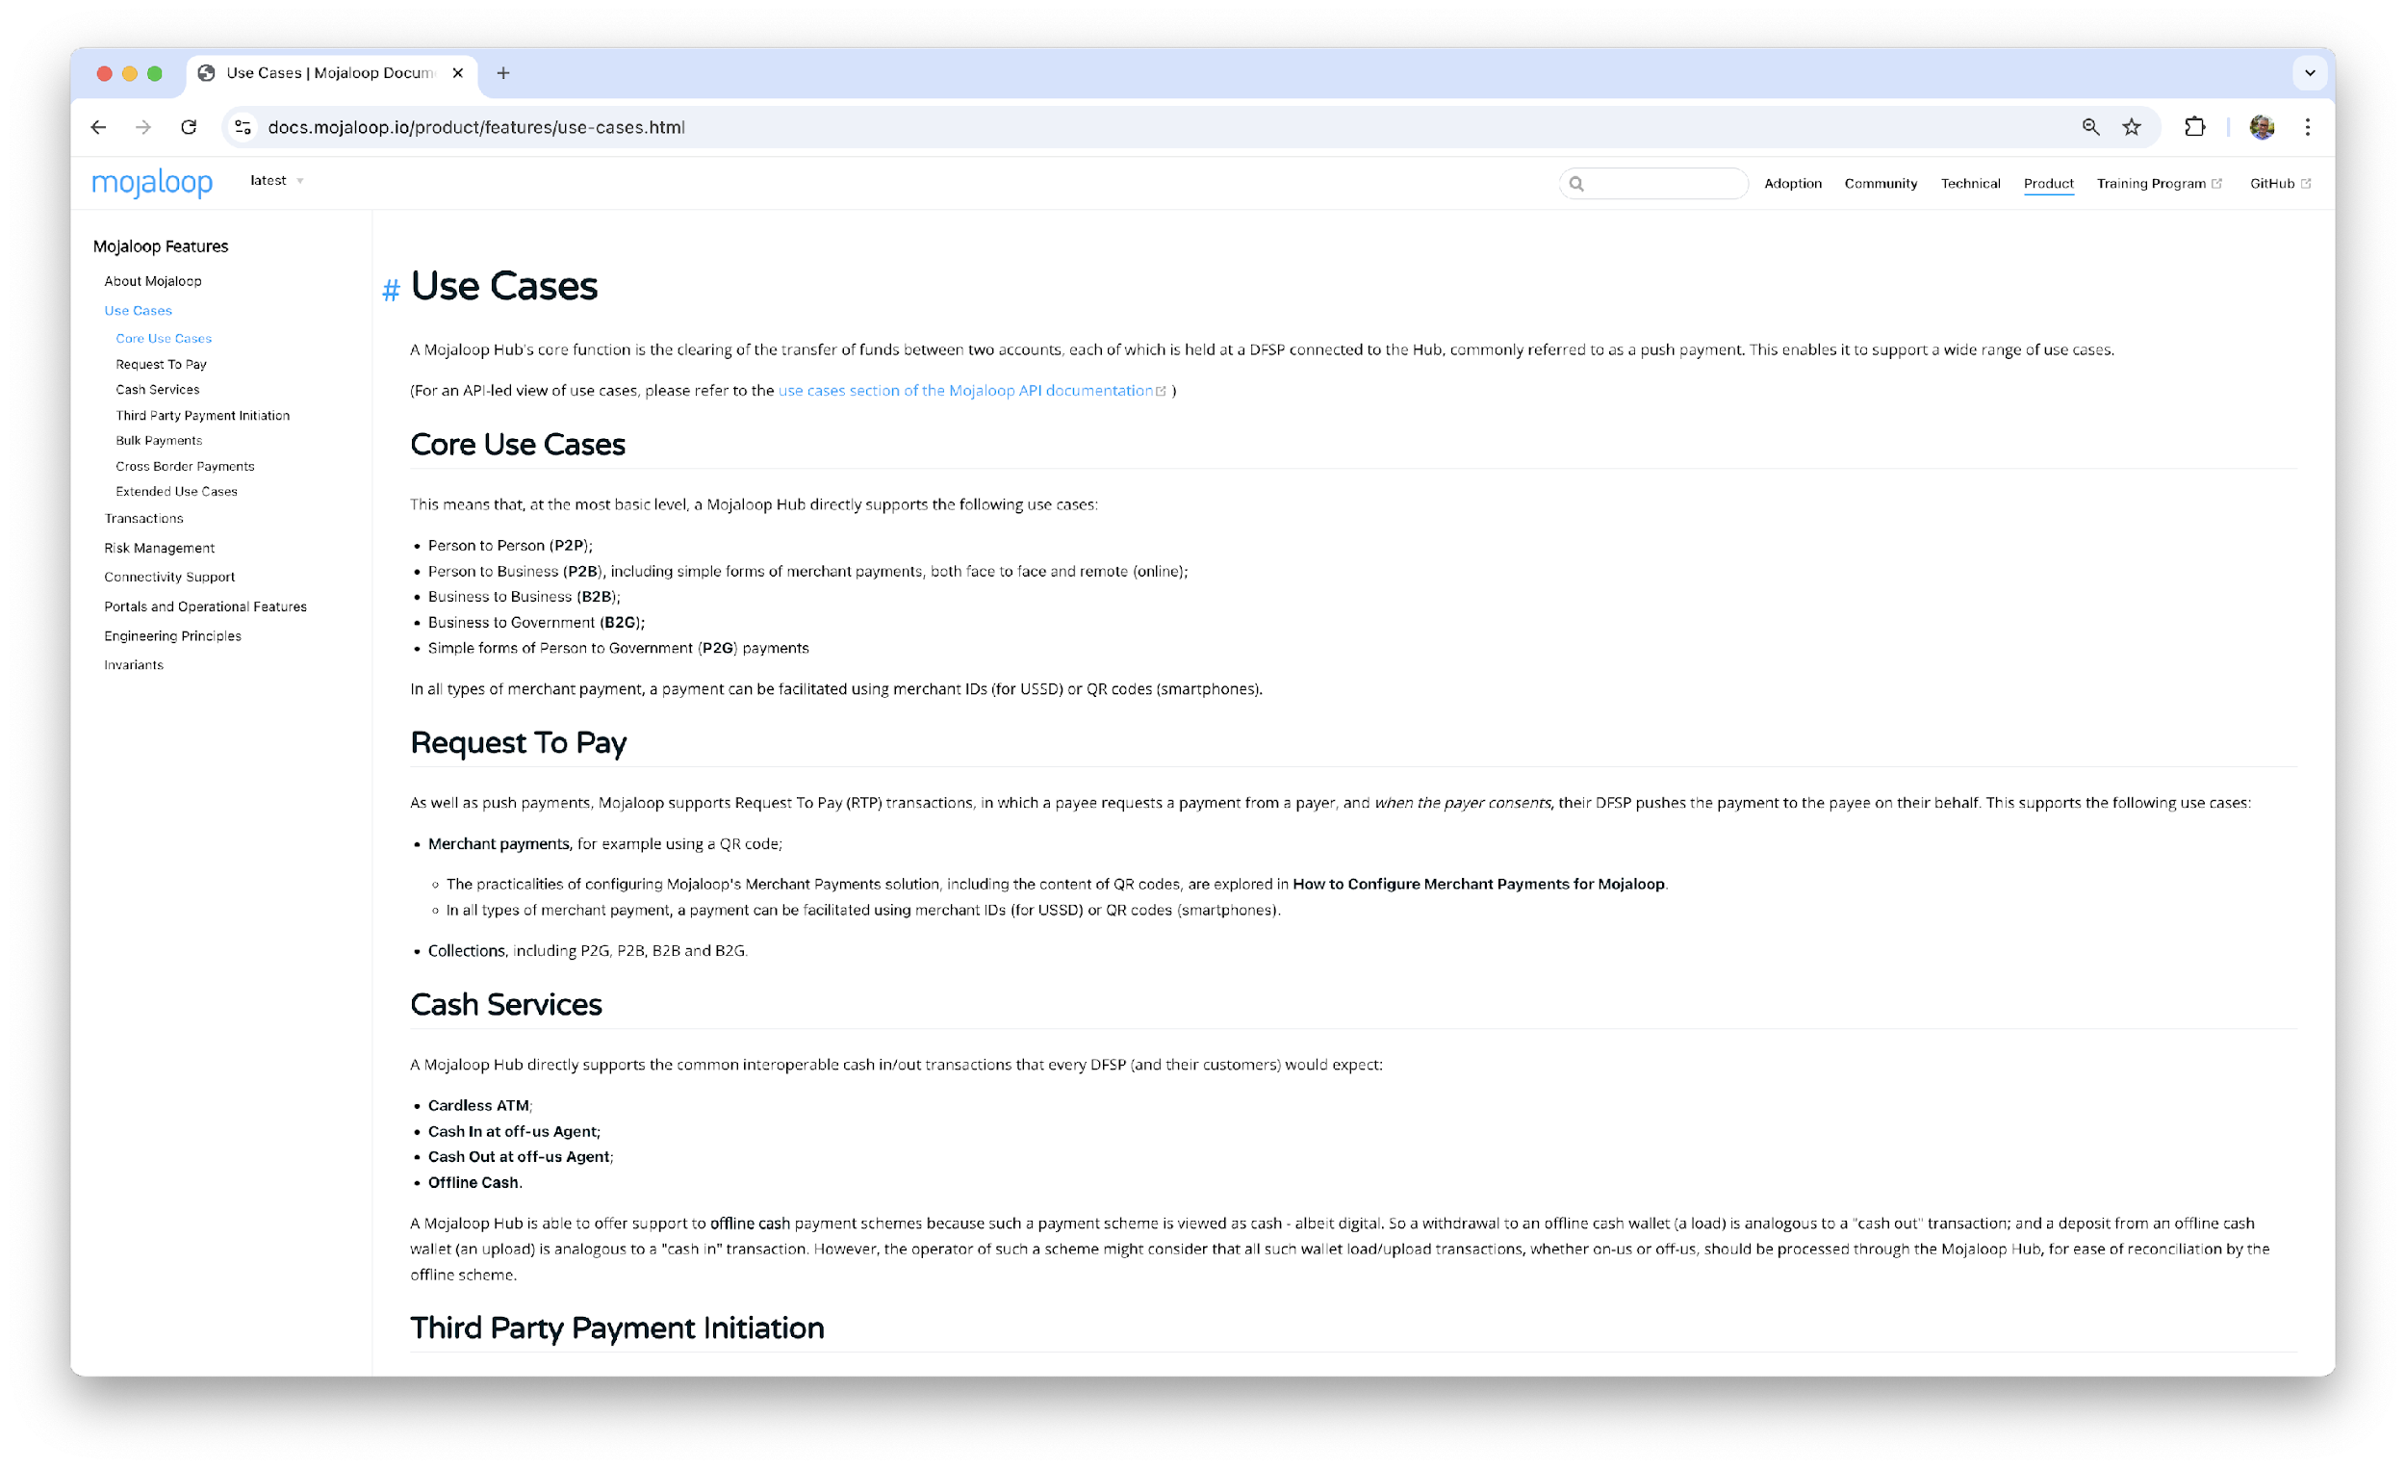
Use Case Documentation: Product-Led
https://docs.mojaloop.io/product/features/use-cases.html

Slide 11
Software Deployment

Slide 12
Prerequisites
You need somewhere to host the hub software:
On-premises servers, firewalls, networking in your own or a shared data centre
Public cloud e.g. AWS, GCP, Azure
Private cloud e.g. OpenStack, VMWare, Hyper-V
Hybrid
For help figuring this out…
MLF GTM team guidance
Mojaloop community members (https://mojaloop.io/service-provider-directory/)
Recommendations and guidelines: https://github.com/mojaloop/on-premises-deployment/blob/main/docs/Software%20Deployment%20Recommendations.md#general-recommendations-for-mojaloop-kubernetes-node-pool-configuration

Slide 13
Prerequisites
You need to decide which use-cases you want to operate:
P2P, B2P, G2P etc…
You need to decide which account identifier types you want to support:
MSISDN, Bank Account No., Alias, Merchant ID etc…
For help figuring this out…
MLF GTM and Product teams guidance
Mojaloop community members (https://mojaloop.io/service-provider-directory/)

Slide 14
Software Deployment Tools
Which components do I need to deploy?
Mojaloop Core services
Supporting services
Depending on chosen use-cases and identifier types.
Additional Mojaloop services
Platform Management services

Slide 15
Software Deployment Tools
User Type / Operational Scenario | Learning / Evaluation | Feature Development | Testing | Production / Live Operation
Developer | Core Test Harness | Miniloop or HELM charts | Miniloop or HELM charts
Quality Assurance | Core Test Harness | Miniloop or HELM charts | Miniloop or HELM charts
System Integrator | Core Test Harness | Miniloop or HELM charts | Miniloop or HELM charts | Mojaloop IaC (Infrastructure as Code)
Hub Operator | Core Test Harness | Miniloop or HELM charts | Miniloop or HELM charts | Mojaloop IaC (Infrastructure as Code)
* simplified from full deployment tools feature matrix (see #ws-deployment-tools on the Mojaloop slack workspace)

Slide 16
Software Deployment Tools
Core Test Harness
For use by single users to deploy Mojaloop services on a workstation or laptop
Low resource requirement
Facilitates learning, feature development and testing
Does not require Kubernetes
Manual security configuration is required
https://github.com/mojaloop/ml-core-test-harness

Slide 17
Software Deployment Tools
Miniloop
For use by single users to deploy Mojaloop services on a workstation or laptop
Low resource requirement
Facilitates learning, feature development and testing
Simplified HELM deployment, requires and installs “developer version” of Kubernetes
Manual security configuration is required
https://github.com/mojaloop/mini-loop

Slide 18
Software Deployment Tools
HELM Chart(s)
Deploys Mojaloop services on machines already running Kubernetes (could be workstation, laptop, own servers, public or private cloud)
Variable resource requirement depending on usage
Facilitates more complex feature development and more “production like” testing
Requires a functioning Kubernetes cluster (one or more nodes)
Manual security configuration is required.
May be used for production deployments but requires greater level of your own infrastructure setup, configuration and management effort.
https://github.com/mojaloop/helm

Slide 19
Software Deployment Tools
IaC (“Infrastructure as Code”)
Deploys a complete Mojaloop infrastructure management platform on own servers, public, private or hybrid cloud
Facilitates enterprise wide creation, provisioning, management and full lifecycle operation of multiple Mojaloop environments e.g dev, test, production
Designed for highly secure production operations
Variable resource requirement depending on usage
Horizontal scalability enables scale-up from low cost starting point as throughput increases.
https://github.com/mojaloop/iacv2-docs

Slide 20
Participant Onboarding and Lifecycle

Slide 21
Participant Onboarding and Lifecycle
Mojaloop provides a set of open-source documentation and software tools to help DFSPs join and participate in Mojaloop based payment schemes
Business and technical integration documentation:
System Integrator Toolkit: https://infitx-org.github.io/participation-tool-docs/
Participant connection management system (MCM) (https://github.com/pm4ml/connection-manager-api)
Integration software:
“SDK” code library (https://github.com/mojaloop/sdk-standard-components)
“Mojaloop Connector” (https://github.com/mojaloop/sdk-scheme-adapter)
DFSP back-office connectors (https://github.com/mojaloop/ml-reference-connectors)

Slide 22
Participant Onboarding and Lifecycle
System Integrator (SI) Toolkit
Designed for system integrators collaborating with stakeholders in DFSPs, this toolkit provides comprehensive guidance for successful integrations with an instant and inclusive payment system powered by Mojaloop
Step-by-step guidance on both technical and business concerns of joining and operating within a Mojaloop based scheme
https://infitx-org.github.io/participation-tool-docs/

Slide 23
Participant Onboarding and Lifecycle
Participant Connection Management System (MCM)
“Mojaloop Connection Manager” simplifies the business and technical processes of onboarding and long-term scheme participation for both hub operator and DFSP.
Secure, “wizard” style technical connection setup and management interfaces.
Enforces best practices for cyber-security for both hub operator and DFSPs
Designed to work out-of-the-box with a wide range of other Mojaloop integration technologies
https://github.com/pm4ml/connection-manager-api

Slide 24
Participant Onboarding and Lifecycle
SDK Code Library
Off-the-shelf, tried and tested, best practice implementations of the Mojaloop connection security specification
Off-the-shelf, tried and tested, best practice implementations of the Mojaloop transactional API specification, including all Mojaloop non-repudiation features like end-to-end cryptographic message signing, signature validation and the crypto hash lock.
Frameworks for building standardised integration solutions
https://github.com/mojaloop/sdk-standard-components

Slide 25
Participant Onboarding and Lifecycle
Mojaloop Connector
Off-the-shelf, tried and tested, implementation of a secure, scalable DFSP-side Mojaloop API interface which connects DFSP back-office systems to Mojaloop hubs.
Eliminates much of the time, cost and risk associated with a DFSP building an integration
Supports all common DFSP scenarios from cheap single-board devices, to large enterprise grade self or cloud hosted IT platforms
https://github.com/mojaloop/sdk-standard-components

Slide 26
Participant Onboarding and Lifecycle
DFSP Back-Office Connectors
Library of off-the-shelf, tried and tested, implementations of secure, scalable DFSP-side back-office and core banking system interfaces which connect DFSP back-office systems to Mojaloop hubs.
Eliminates much of the time, cost and risk associated with a DFSP building an integration
Supports all common DFSP scenarios from cheap single-board devices, to large enterprise grade self or cloud hosted IT platforms
Template available to bootstrap new integrations
https://github.com/mojaloop/ml-reference-connectors

Slide 27
Next Steps
It’s not just about the technology

Slide 28
Phases: The Path to a Live Service
POC (or UAT) | Pilot | Full implementation | Business as usual
No real money Ideally cloud based Ideally 1 use case 2-3 DFSP test environments connected Simulated operations Happy path only No regulator approval required MLF can execute | Real money Limited access to specific customers Limited number and size of transactions per day based on risk appetite Manual operations and settlement (i.e. not integrated to Hub Ops and RTGS) No redundancy No uptime expectation | Real money No limitations on number of DFSPs, and throughput Ideally multiple use cases Full redundancy and maximum uptime expectancy Automated operations and settlement if available | Adding new use cases Adding new DFSPs Maintenance and improvements

Slide 29
Verticals: It’s Not Just About the Technology
Governance | Includes scheme rules such as pricing, ownership, scheme decision making, business case, policies, project governance
Hub Operations | Building the capacity of the hub operations team to operate the Mojaloop platform including both business and technical operations.
Support Ecosystem | Connecting adopters to service providers and training service providers and local fintechs. Procurement processes. Connecting adopters to the community and global partners.
Product | Defining platform requirements and implementing the Mojaloop platform to those specifications
Infrastructure | Defining infrastructure requirements and procuring infrastructure, whether cloud or on premise.
Participation | All processes related to engagement, integration, onboarding of DFSPs to be supportive and active participants in the IIPS.

Slide 30
Governance
Objective: The overall goal of the governance vertical is to set up a digital payments scheme that causes transformation in the payments ecosystem by facilitating interoperable digital payments for all. This is achieved through both setting up a Level One-aligned scheme and managing the project work effectively to deliver this efficiently for all stakeholders.
Scheme Governance
Scheme rules including pricing
Project Governance
Policy
Business case for scheme and hub operator
We made a conscious decision to include all scheme, policy and business related components in one vertical as generally require similar levels of decision maker involvement from participants and policy makers, similar consultants are hired, and they are interconnected. The overlaps were so many that separating them seemed arbitrary.

Slide 31
Hub Operations
Objective: Getting a well-equipped team within an effective team structure is essential both for the project phase, and the ongoing sound administration of a payments switch. This vertical pays attention to both the capacity of the team to deliver on the scheme mandate and objectives, while providing the policy and process frameworks needed to deliver on sound technical and business operations.
Staffing and capacity building
Technical and Business Operations Framework
We made a conscious decision to include all scheme, policy and business related components in one vertical as generally require similar levels of decision maker involvement from participants and policy makers, similar consultants are hired, and they are interconnected. The overlaps were so many that separating them seemed arbitrary.

Slide 32
Support Ecosystem
Objective: To ensure that adopters have access to the right support at the right time for the deployment, maintenance, iteration and operations of their IIPS. Primarily accomplished by ensuring adopters and service providers have adequate understanding to communicate needs and requirements through a well informed procurement process. Enable sovereignty and lowering the cost of operations of the IIPS by enabling local system to provide as much support as desired by the adopter while still aligning with the Mojaloop community.
Training local system integrators and fintechs
Facilitating adopter engagement in the community
Defining a long term support and maintenance model
Developing and implementing a procurement strategy for all components
Sovereignty and local support has become the major selling point for Mojaloop. It will not be the case everywhere but this vertical will aim to enable sovereignty when possible. That must be matched with quality support. However in each case, it should be the country adopter who decides and leads that process and no one else.

Slide 33
Product
Objective: The objective of the application vertical is to deploy and operate a Mojaloop OSS product that meets the scheme needs as defined at each phase, while meeting the stability, scalability and performance baselines defined for the environment it’s deployed in.
Defining local requirements for the application
Deployment and maintenance of the platform
Delivery of required functionality according to local context
This section is everything related to the actual Mojaloop application deployment. It is specifically not related to the end use product or application

Slide 34
Infrastructure
Objective: A secure infrastructure that provides adequate resources and takes advantage of Mojaloop architecture. The infrastructure should be cost effective and meet all regulations for data security and sovereignty.
Defining local requirements for the application
Deployment and maintenance of the platform
Delivery of required functionality according to local context
We separated this from the Mojaloop product and application on purpose as it is often a separate procurement process and team to work on it. Most adopters have a separate infrastructure strategy which encompasses other applications as well.

Slide 35
Participation
Objective: To deliver on a Mojaloop-based IIPS, the integration process of DFSPs needs to be as seamless and efficient as possible. While complexities are unavoidable, building the right integration model and using the right tools for each DFSP category, based on technology maturity and resource availability, the onboarding journey should minimize resources required while reducing the time from taken to successfully connect a DFSP to the hub.
DFSP Engagement
Integration Tooling and Design
DFSP Onboarding
We separated Participation from other sections because it actually touches on scheme rules, business strategy, product design, and hub operations.

Slide 36
Thank you

